Slide 1
JobView Visualizing ADP’s Employment Report
July XX, 2016

Slide 2
Mid-term Presentations (week 9 – 7/7/16)
You will give a 15-minute presentation showing your prototype thus far during the week nine live session. At this point, you should have some form of prototype that can demonstrate the interactions. You might do this with Keynote or PowerPoint, for example. You may use a static drawing program if you can explain the interaction thoroughly. You can show your work in code if you like, but it's not required at this stage. You should show several iterations of designs that your group has considered and explain why you made the choices you made to get the current design. You should also explain how you plan to test your design. The use of supporting slides is encouraged. All team members must participate in the presentation.
Points to be sure you cover:
Deck mockup (Amin)
Current ADP state: what is the NER? (Roiana)
Target audience and appropriate audience tasks (Amin)
User Discovery research (Roiana and Saad)
observation of how journalists use NER
Interviews with financial professionals
Deeper dive on dataset (what cuts does it have) and how you are using it (Saad)
Iteration of your design (Amin and Roiana)
Your complete current mockup (Amin and Roiana)
Testing plan (esp. UAT) (Amin)
email address for receiving feedback (Saad)
Feedback for presentations: Each member of a group will be assigned to give feedback to another group (group 1 members each provide their thoughts to group 2, group 2 to group 3, etc.). See the midterm presentation peer review google doc for a list of questions to consider. Try to make your notes during the presentation itself so that you can send your feedback right away. Your group’s presentation should include an email address to which your peer reviewers can send their feedback.

Slide 3
Comments from Daniel on Proposal
Amin, Roiana, and Saad, The project concept sounds good overall. Ensure that the vis goals reflect the needs of the key stakeholders mentioned (e.g., small businesses, policy makers, economists) and that the chart design is not just refining existing charts (although these are good to know about for reference). Consider talking to a few potential users early on to see if the current goals align with their interests in the data. Also, as a note, be aware of trade offs in representing data at the state level by a geo vis of the US as this can perceptually favor states with a larger area.
Let me know if you have any questions. I’m always happy to look at mock ups and to provide feedback and guidance along the way.

Slide 4
Assignment 6: Usability Testing (graded)
In this assignment, you will conduct a usability test with the current prototype of your final project. You may use a paper prototype if necessary, but it’s best to use a live, interactive one. Although this is an individual assignment, you should work with other members of your group to develop the set of test tasks and questions. When your testing is complete, you will turn in a prioritized list of your own findings for this assignment. Your group will then create a master prioritized list for the project itself, to be discussed during your final project presentation. You should review the usability testing materials from Week 4 before doing this assignment.
Working with the rest of your team, develop a set of test tasks with good coverage of the content and interactions in your prototype. Make sure your task instructions are specific. Include a few debriefing questions at the end as well.
Arrange to meet with a test subject either in real life or virtually. (If using a paper prototype, this must be in real life.) Make an audio or audio/video recording of the session. Remember to focus on observing rather than interviewing. You want to see what the user can do without your help, not ask them how they would design the visualization. Limit yourself to making brief, if any, notes during the testing session. Make more complete notes after reviewing the recording (best to do within 24 hours of the test). Your notes should reflect what you observed about the user’s behavior with the prototype. Where did they make errors? Where did they go off track? What do you believe caused them to do so? From your notes, make a prioritized list of issues to be addressed, along with suggested solutions. Use MoSCoW prioritization.
Turn in a list of your group’s test tasks and questions, your notes on the test, and your prioritized list of issues and changes. We will be looking for appropriateness of test tasks and debriefing questions, thoroughness, attention to what the user does, accurate prioritization, and strong correlation between observations and suggestions for improvement.
Assignment due date: 12 noon PST, day of week 13 live session

Slide 5
What is the ADP NER?
ADP, a payroll service provider, produces an estimate of total employment in the US each month through its National Employment Report (NER).
The NER is closely watched by journalists and financial markets as it provides an indicator of the health of the economy and comes out a few days ahead of the official government employment report.
These data are displayed in a static format on the report’s website.
Our aim is to explore new and interactive ways for users to engage with the data and easily consume the economic insights that emerge from them.

Slide 6
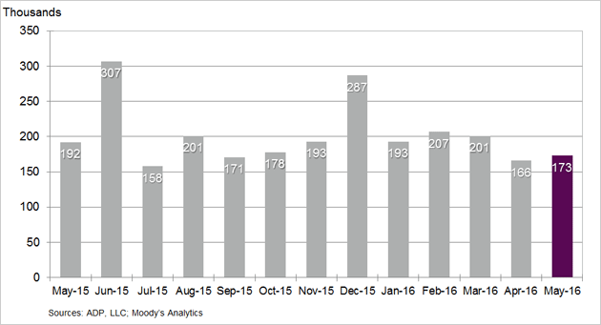
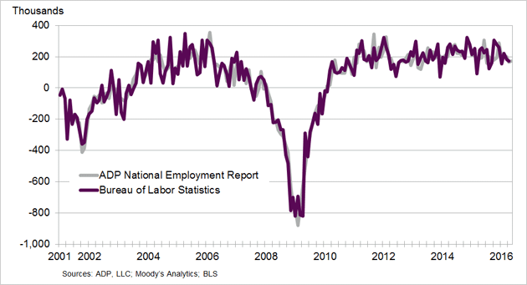
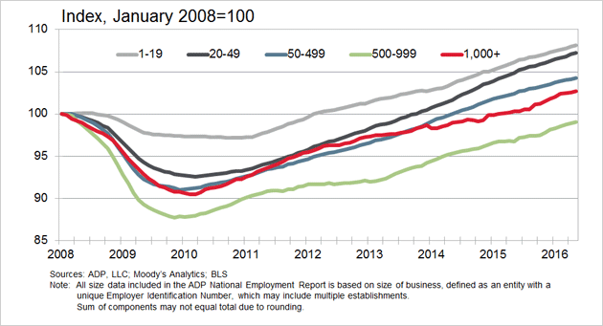
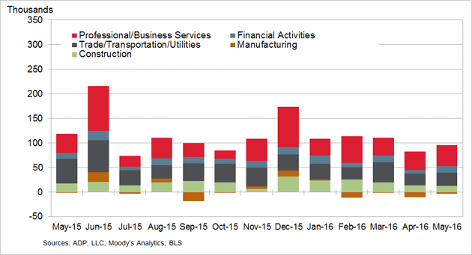
Current state of ADP: STATIC
Change in Nonfarm Private Employment
Change in Total Nonfarm Private Employment
Change in Total Nonfarm Private Employment by Company Size
Change in Total Nonfarm Private Employment by Selected Industry

Slide 7
Business journalists and financial professionals are our target audience
Category | Stakeholder | Likelihood to visit | Need from Data | Visualization Need
Target Users | Business Journalists | High (need to deliver timely business insight to a general audience) | Want to report the most recent numbers Statistics to support a current story Background to inform a potential story | Communicative Make it simple to understand trends Give me a visual to support my story
 | Economists / Financial professionals | Medium / High (likely to get data from Bloomberg or aggregating data source) | Most recent data to inform economic models Investigate predictors to help forecast market movements | Exploratory Give me the raw data, so I can play with it myself Help me see trends to inform my own hypotheses
Potential future focus | Students | Medium (awareness of ADP report may be low) | Input to a exploratory model or a paper related to labor / economic concerns | Exploratory Make it easy for me to tailor data to my project
 | Policy makers | Medium (tend to favor official government data) | Context and supporting data for proposed legislation | Communicative Make it easy for me to see trends relative to my constituents
 | Small businesses | Low (busy running their businesses) | Put their own experience in context of the broader economy | Communicative Help me understand how I relate to businesses like me

Slide 8
Need for Financial Market Professionals
Global Macro Strategist:
“Using ADP to predict the BLS payroll growth”
“Using ADP to say something more broadly about GDP”
US Economist:
“The most important thing is how well ADP predicts BLS payrolls and with what error”
Interest Rates Strategist:
“How well ADP performed vs the Consensus expectation”
“Of course what ADP implies for the BLS headline number”

Slide 10
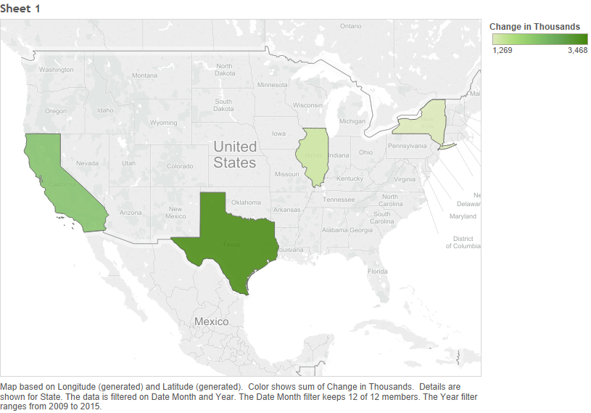
Using a map makes it difficult to view changes over time

Slide 11

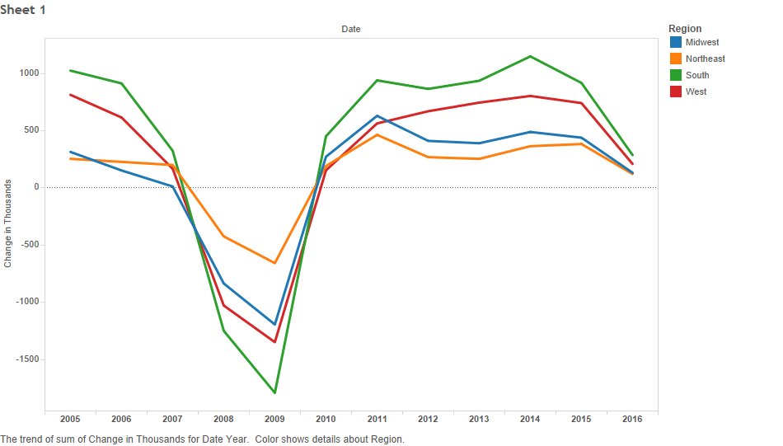
Time series may make more sense Two levels: primary dimension and then filters
By Sector
By Industry
By Region
By State

Slide 12
Iteration 1 (ADP vs BLS)

Slide 13
ADP vs. BLS
Monthly comparison
Button
Notes:
Correlation over entire period, mean absolute difference between both over entire period.
Change and vary time periods, and do correlation and mean absolute difference.

Slide 14
Monthly Comparison of ADP vs. BLS
Monthly comparison
Result of selecting button
Notes:
Change time periods for this.

Slide 15
Iteration 2 (ADP vs BLS)

Slide 16
ADP vs. BLS private payroll growth
Start:
End:
GO
Monthly Comparison
Month
Year
Month
Year
Time period: Jan ‘06 – May ‘16
Correlation: 0.98
Mean absolute error: 45k
Notes:
Correlation over entire period, mean absolute difference between both over entire period.
Change and vary time periods, and do correlation and mean absolute difference.

Slide 17
Monthly Comparison of ADP vs. BLS
Monthly Comparison
Start:
End:
Month
Year
Month
Year
GO
Notes:
Change time periods for this.

Slide 18
Iteration 3 (ADP vs BLS)

Slide 19
ADP vs. BLS private payroll growth
Start:
End:
GO
Monthly Comparison
Month
Year
Month
Year
Thous.
Time period: Jan ‘06 – May ‘16
Correlation: 0.98
Mean absolute error: 45k
Notes:
Correlation over entire period, mean absolute difference between both over entire period.
Change and vary time periods, and do correlation and mean absolute difference.

Slide 20
ADP vs. BLS private payroll growth
Start:
End:
GO
Monthly Comparison
Jan
2012
May
2016
Time period: Jan ‘12 – May ‘16
Correlation: 0.99
Mean absolute error: 30k
Notes:
Correlation over entire period, mean absolute difference between both over entire period.
Change and vary time periods, and do correlation and mean absolute difference.

Slide 21
Monthly Comparison of ADP vs. BLS
Monthly Comparison
Start:
End:
Month
Year
Month
Year
GO
Notes:
Change time periods for this.

Slide 22
Monthly Comparison of ADP vs. BLS
Monthly Comparison
Start:
End:
Jan
2012
May
2016
GO
Notes:
Change time periods for this.

Slide 23
Iteration 4 (ADP vs BLS)

Slide 24
ADP vs. BLS private payroll growth
Start:
End:
GO
Monthly Comparison
Month
Year
Month
Year
Thous.
Time period: Jan ‘06 – May ‘16
Correlation: 0.98
Mean absolute error: 45k
Notes:
Correlation over entire period, mean absolute difference between both over entire period.
Change and vary time periods, and do correlation and mean absolute difference.
Plot the error instead…(linked chart to below it that gives another cut)...Time series of the error (http://www.highcharts.com/demo/synchronized-charts)

Slide 25
ADP vs. BLS private payroll growth
Start:
End:
GO
Monthly Comparison
Jan
2012
May
2016
Time period: Jan ‘12 – May ‘16
Correlation: 0.99
Mean absolute error: 30k
Notes:
Correlation over entire period, mean absolute difference between both over entire period.
Change and vary time periods, and do correlation and mean absolute difference.

Slide 26
Monthly Comparison of ADP vs. BLS
Monthly Comparison
Start:
End:
Month
Year
Month
Year
GO
Notes:
Change time periods for this.

Slide 27
Monthly Comparison of ADP vs. BLS
Monthly Comparison
Start:
End:
Jan
2012
May
2016
GO
Notes:
Change time periods for this.

Slide 28
APPENDIX

Slide 29
Interest in BitCoin and Blockchain has grown rapidly Blockchain is underlying data structure for Bitcoin
Blockchain is all the
rage in the business press
Significant Increase in interest in 2015
1

